Slide 1
IMPORT DATA USING CSV FILE.
Milind Parab

Slide 2
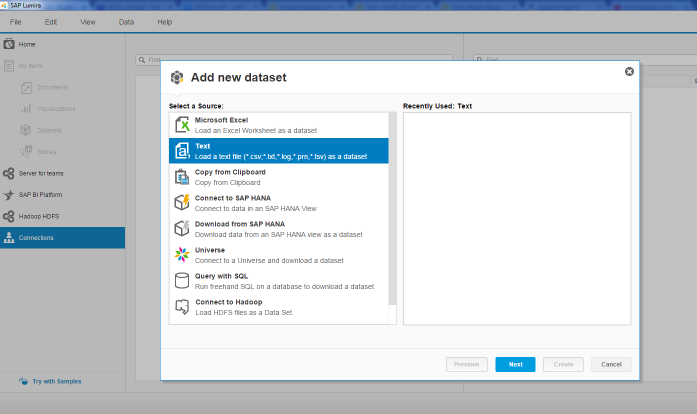
File→New→Text

Slide 3
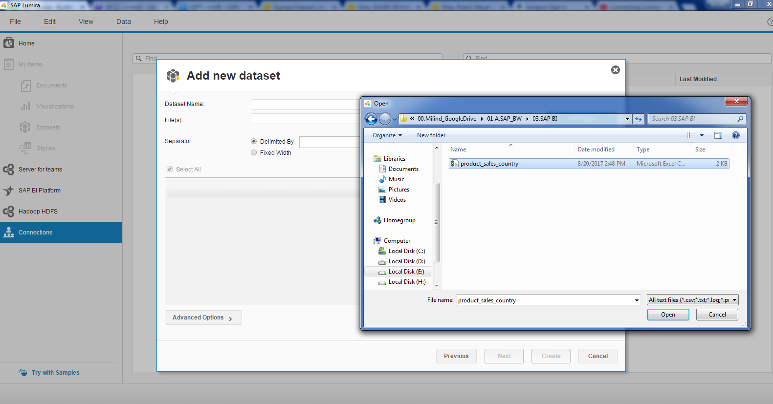
Cont.

Slide 4
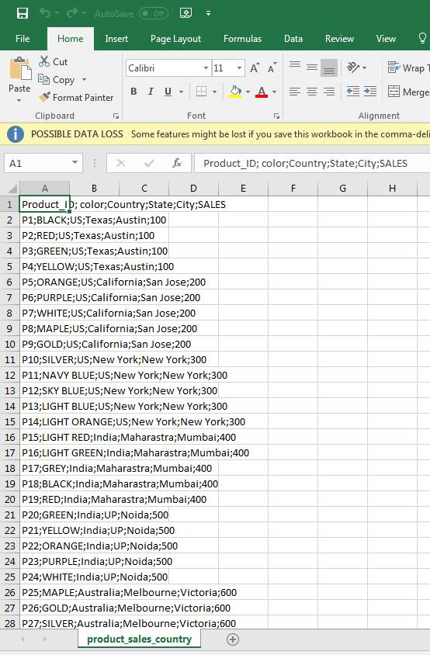
CSV file.

Slide 5
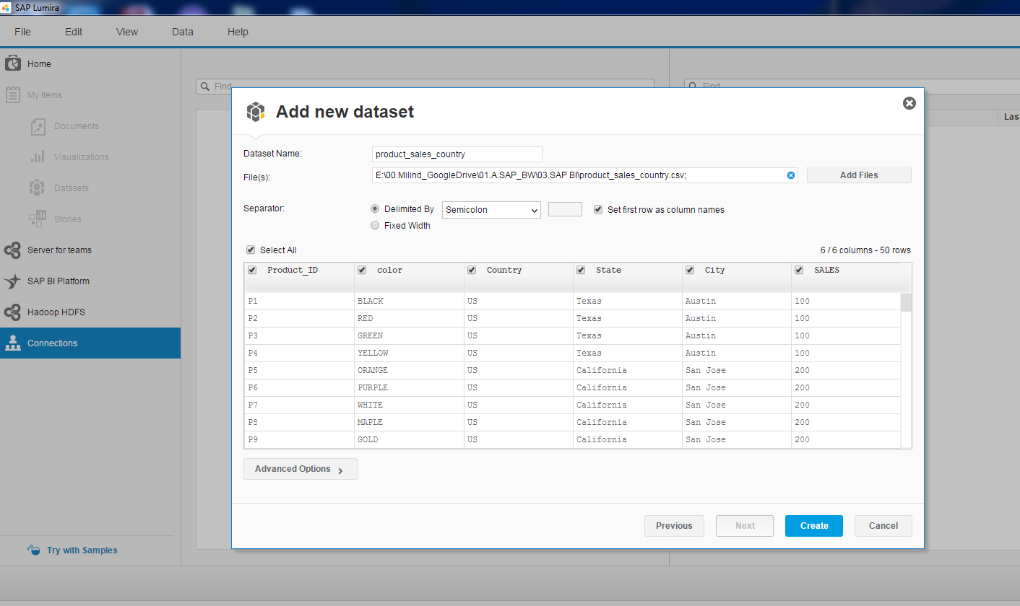
Import the file.

Slide 6
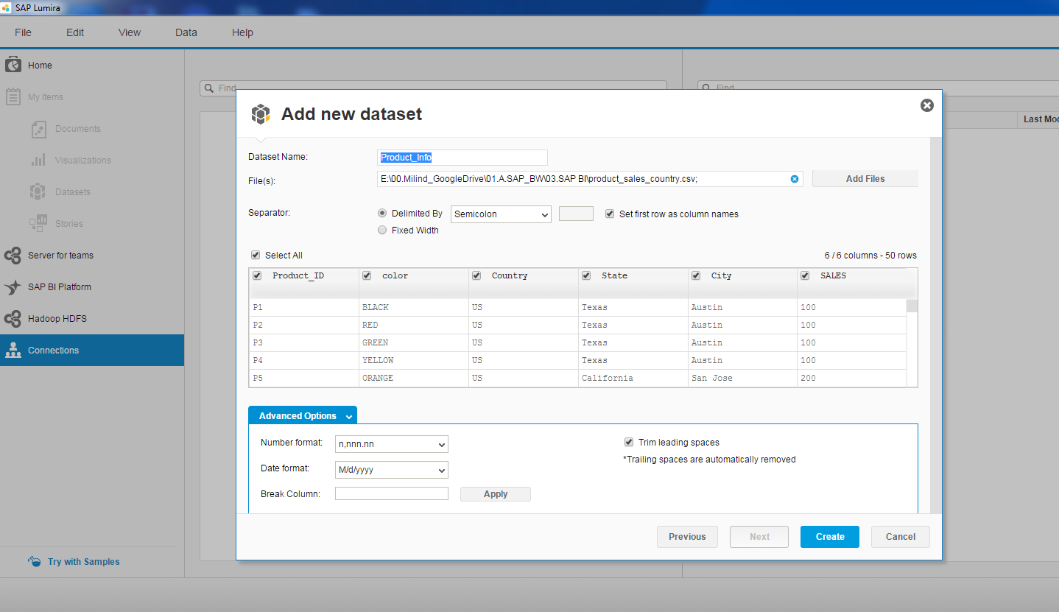
Rename Dataset Name.

Slide 7
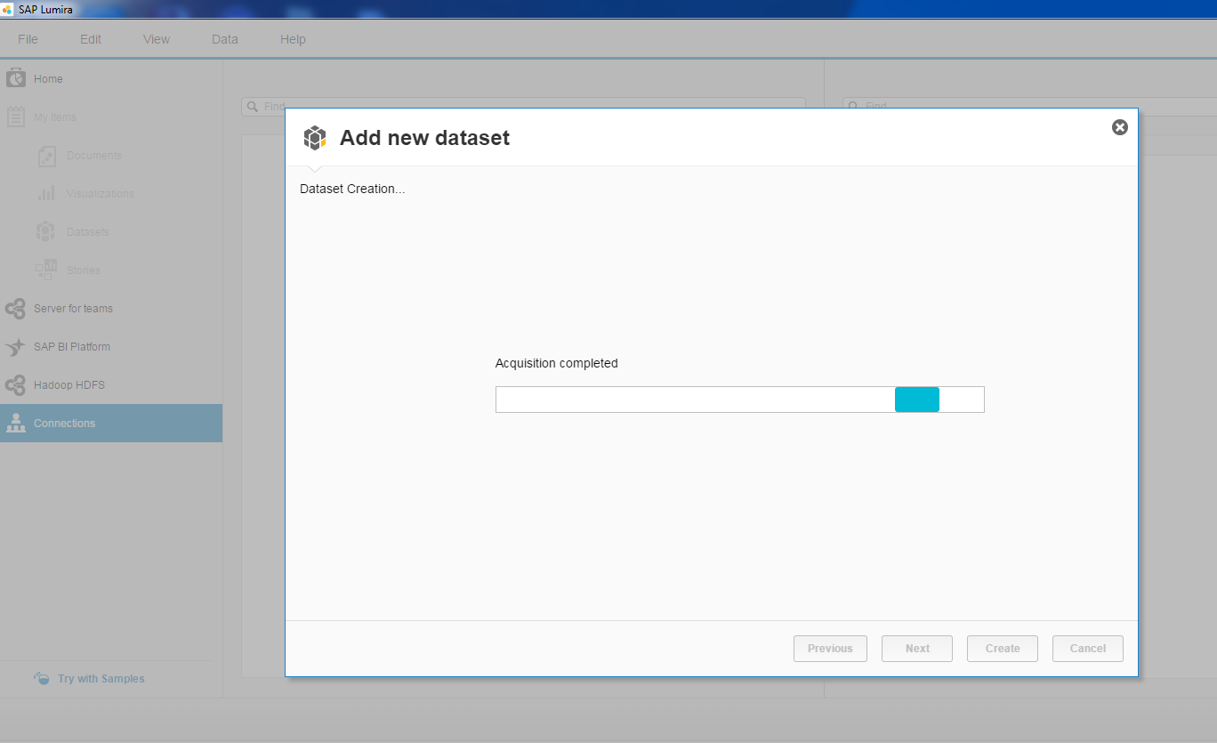
Click Finish.

Slide 8
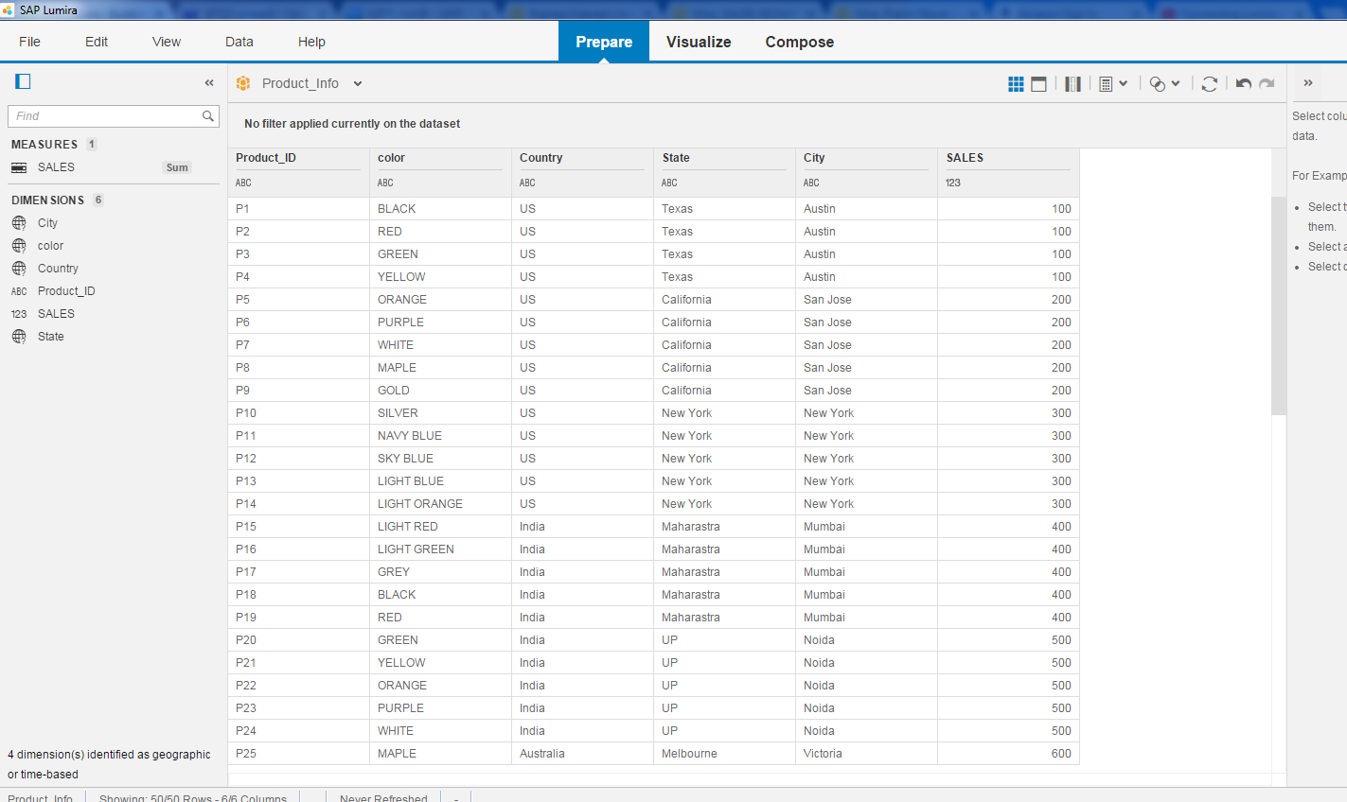
Data Acquisition has been Completed Successfully.

